Slide 1
ISP Introduction
TaoCheng Chen
2015/6/8

Slide 2
ISP
ISP（Image Signal Processor ）
Processing CCD/CMOS Image Sensor output data(RAW data)
ISP is implemented by Hardware, and use pipeline for high speed processing
Our ISP Goal
Black level correction
Defect pixel/gamma/lens shading correction
Wide Dynamic Range (WDR) correction
2D/3D Noise reduction
Image edge sharpness
Auto exposure/white balance/focus adjustment
Digital anti-shake/anti-flog/anti-glare

Slide 3
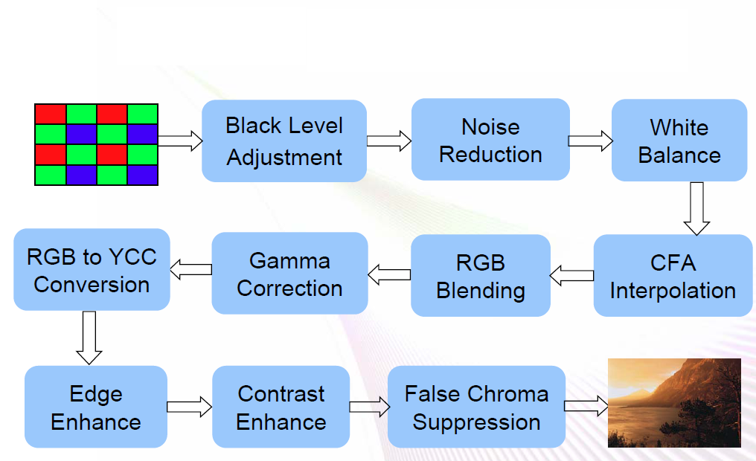
Image Pipeline

Slide 4
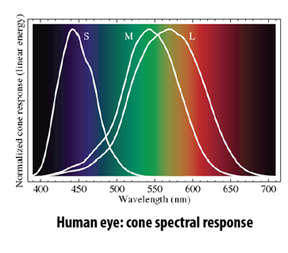
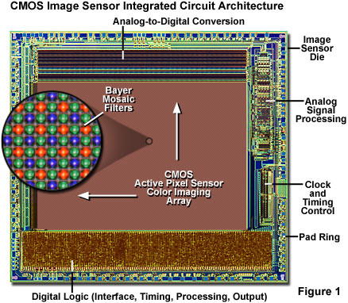
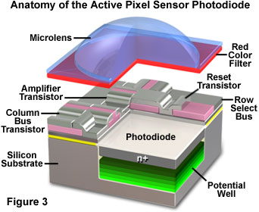
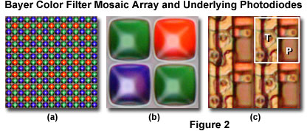
CMOS sensor

Slide 5
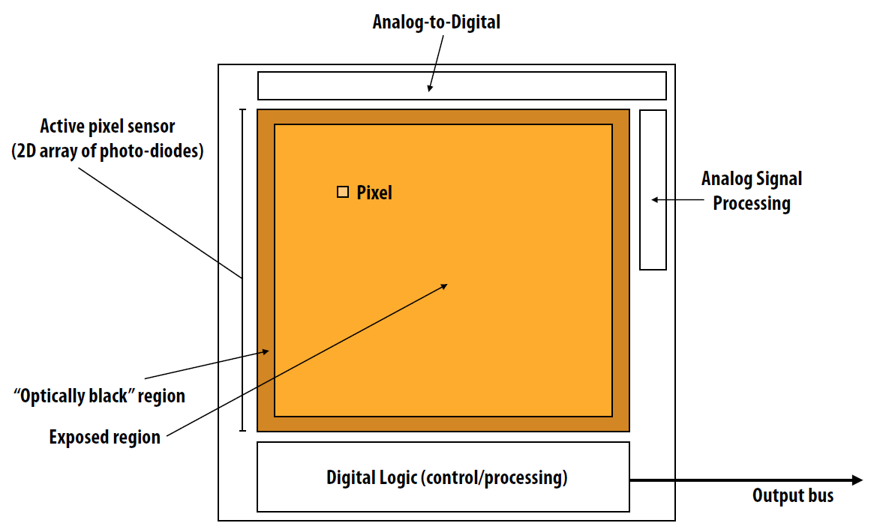
CMOS sensor

Slide 6
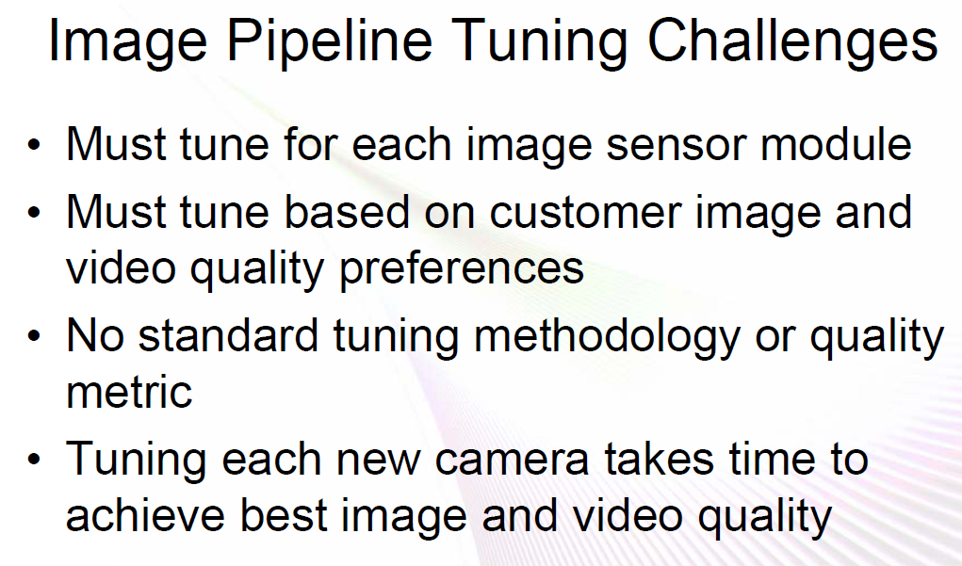

Slide 7
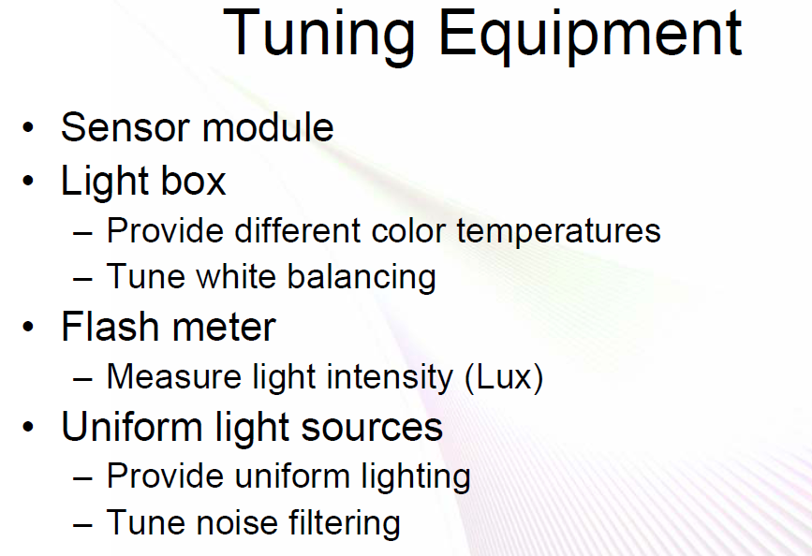

Slide 8
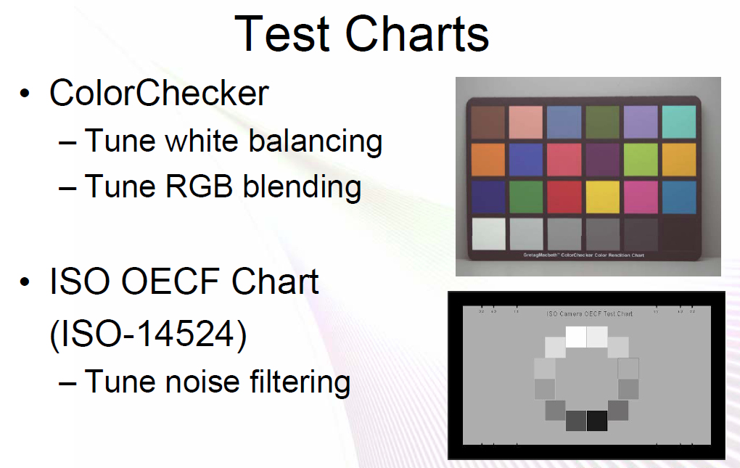

Slide 9
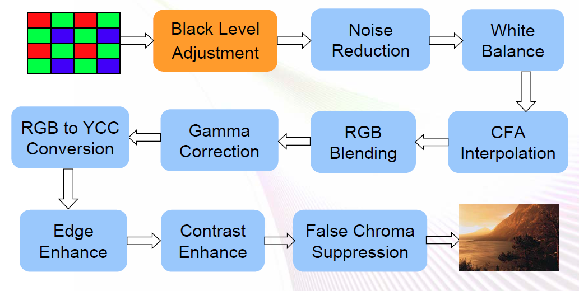

Slide 10
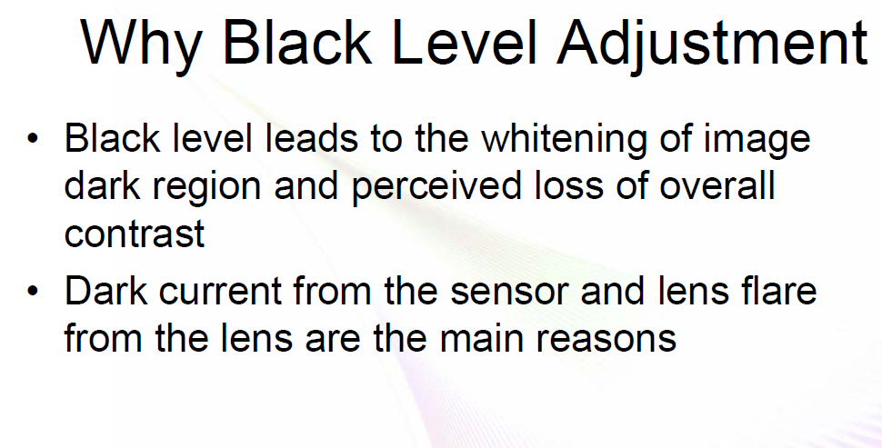

Slide 11
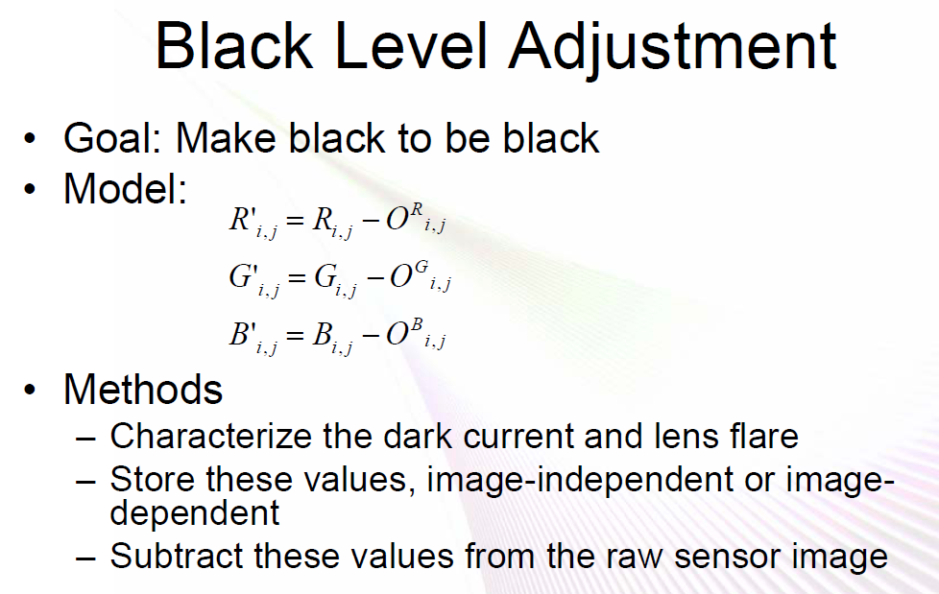

Slide 12
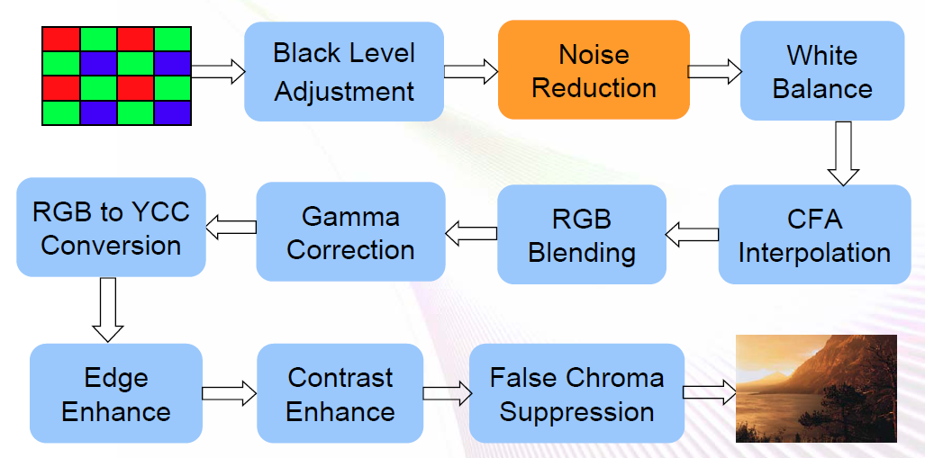

Slide 13
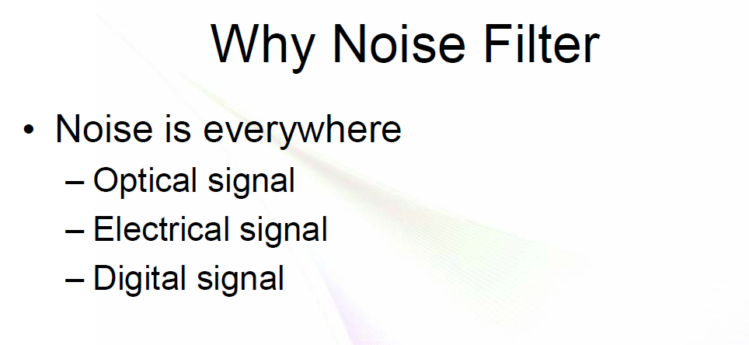

Slide 14
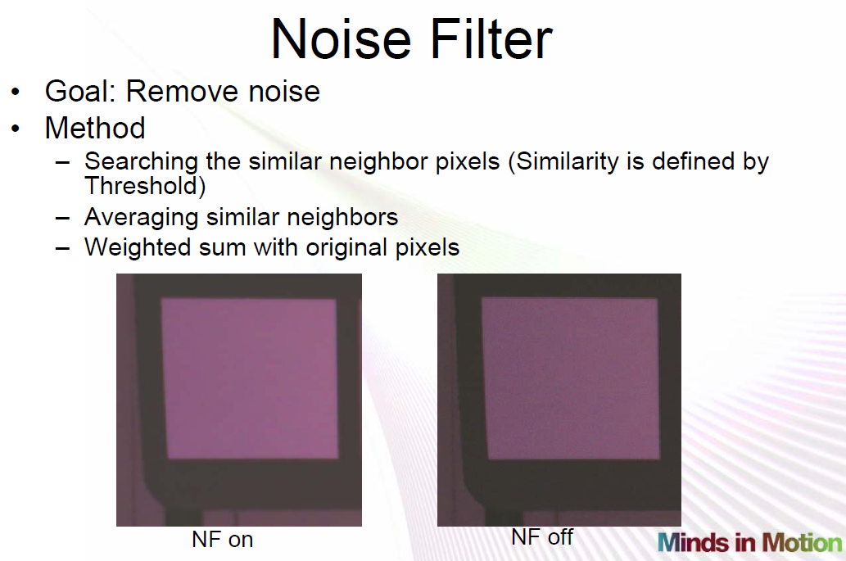

Slide 15
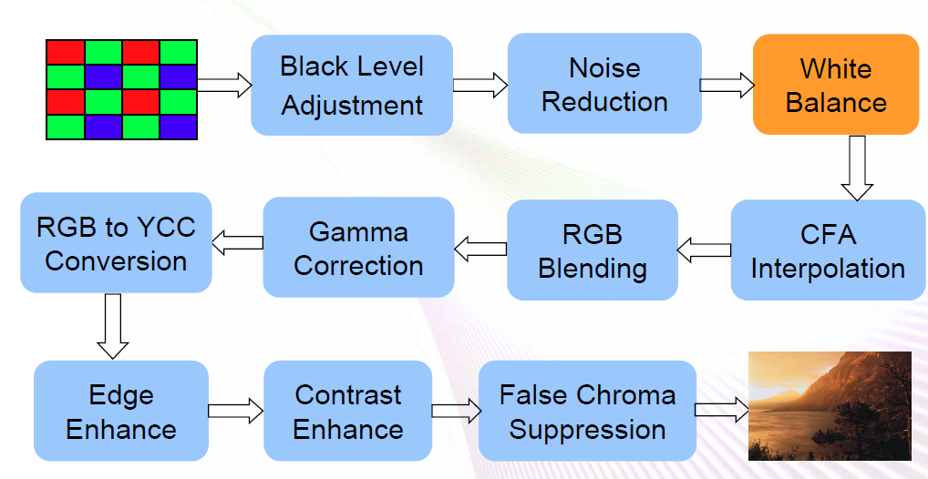

Slide 16
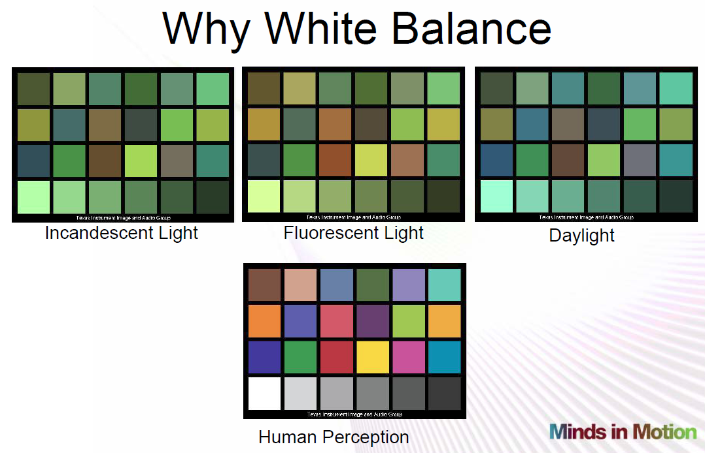

Slide 17
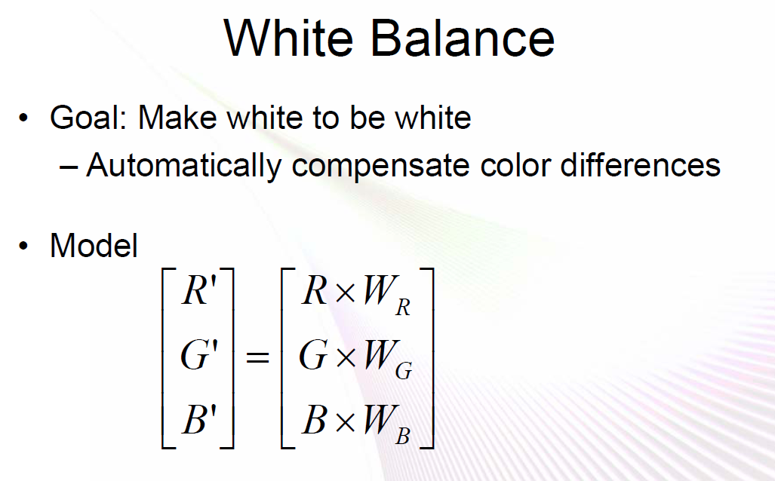

Slide 18
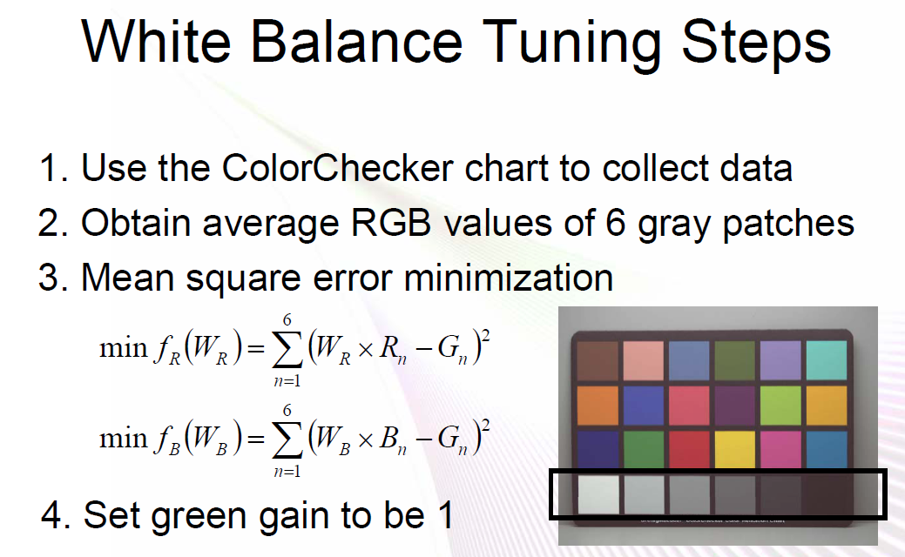

Slide 19
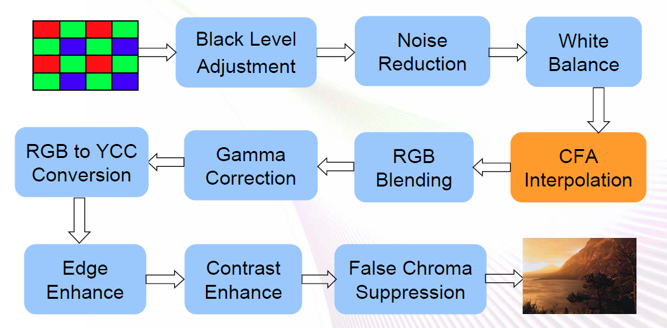

Slide 20
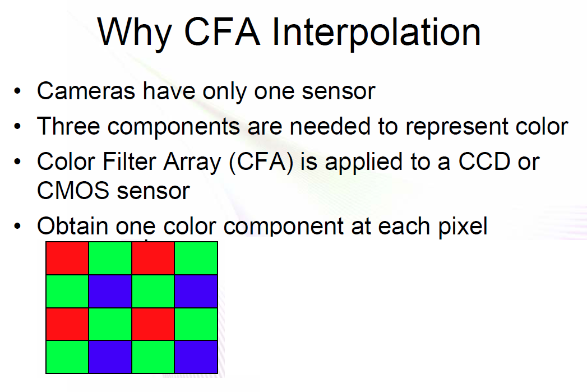
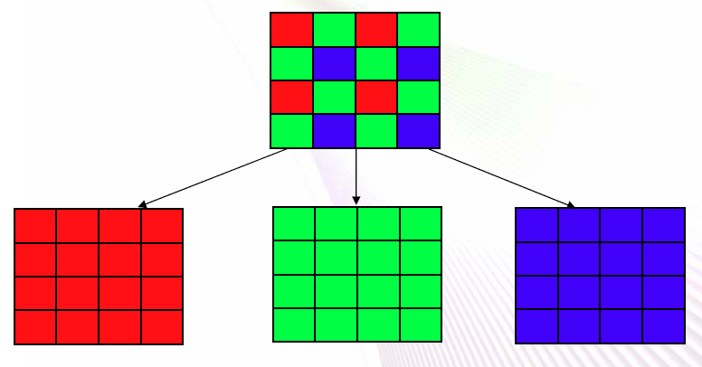

Slide 21
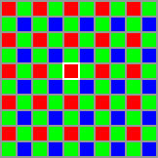
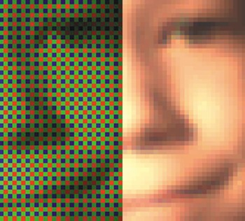
Color Interpolation
Also called de-mosaic / raw2rgb...
Guess missing channels for each pixel by the following:
Neighbor pixels
Edge
Gradient
...
Avoid zigzag and false color artifacts

Slide 22
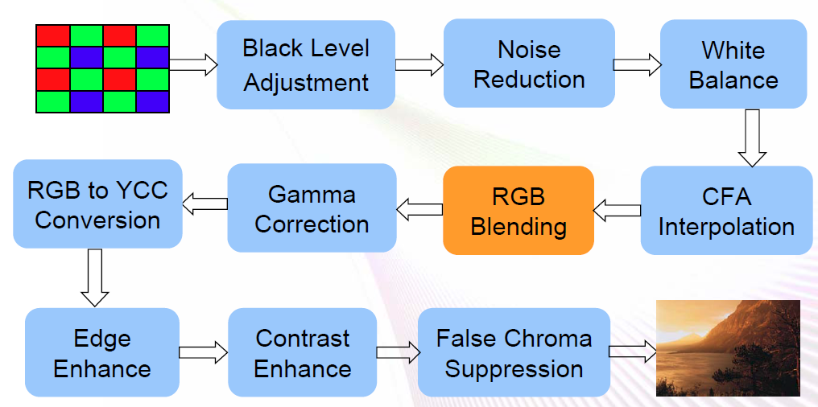

Slide 23
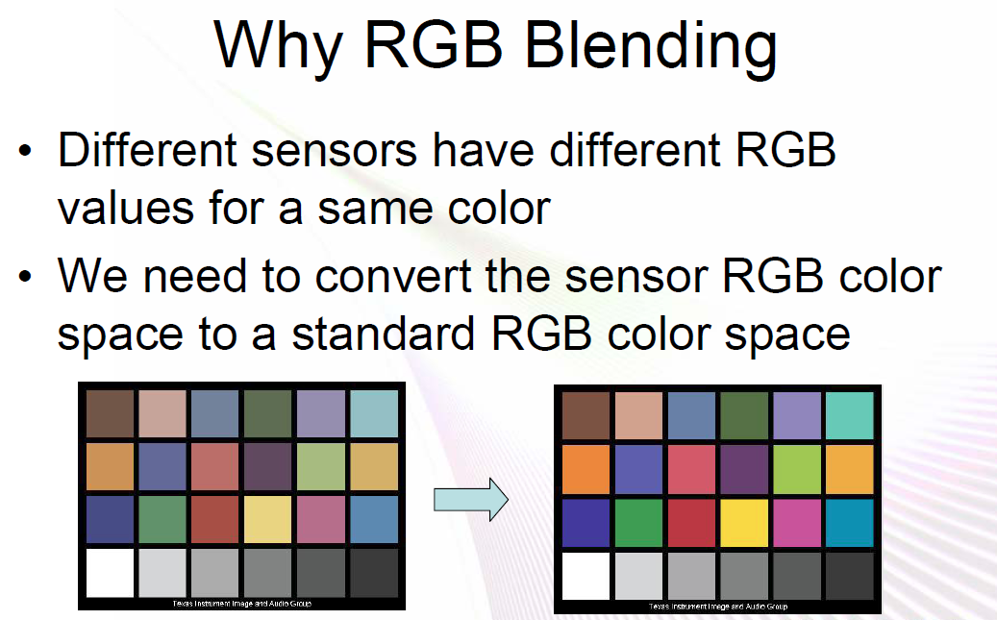

Slide 24
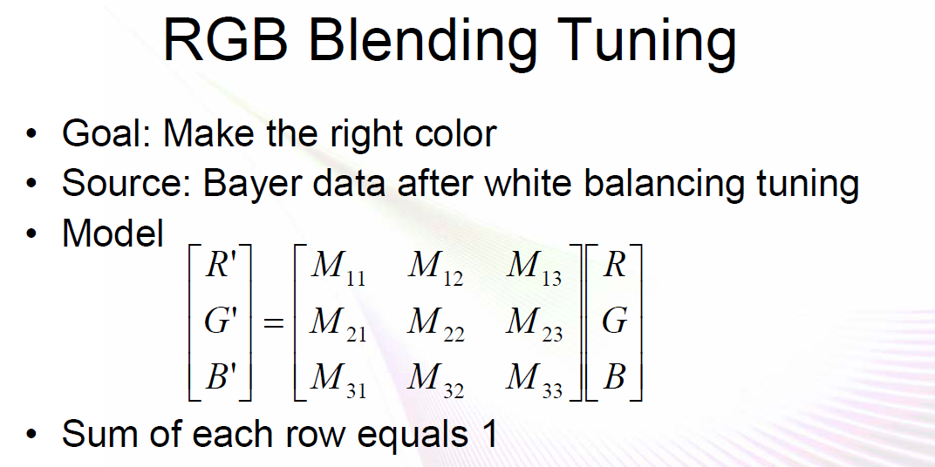

Slide 25
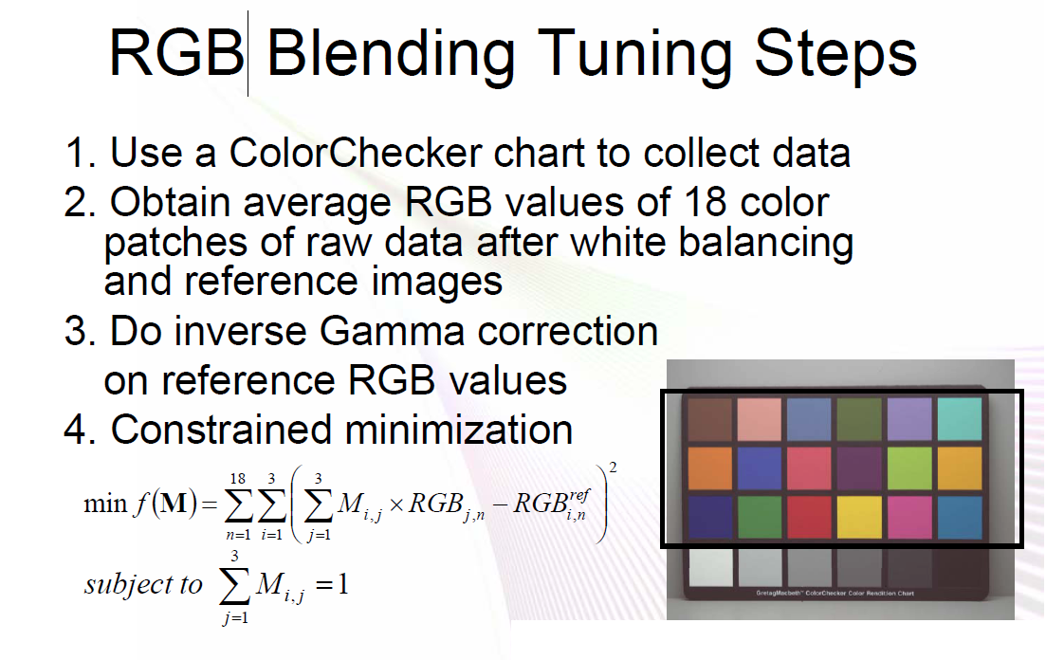

Slide 26
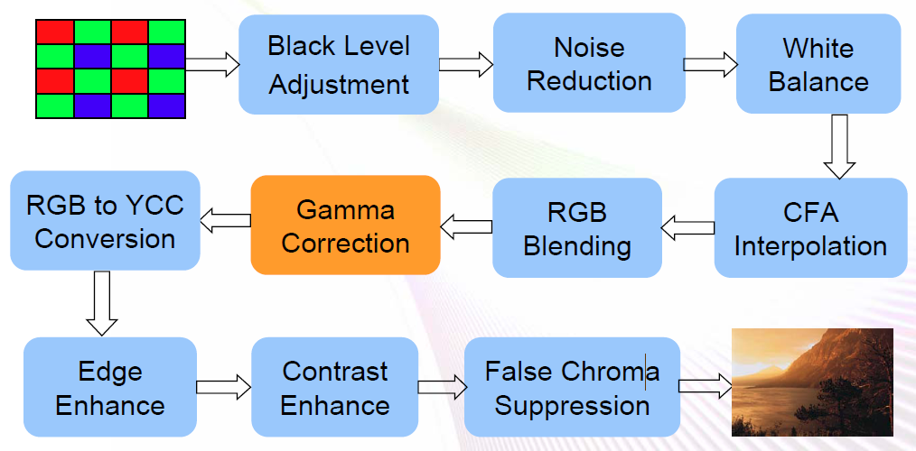

Slide 27
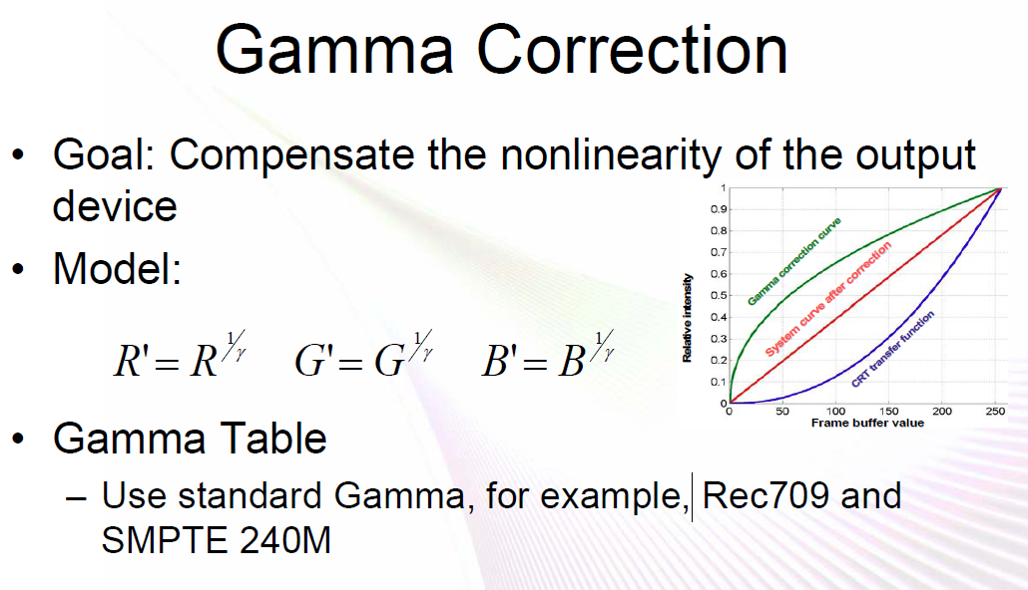

Slide 28
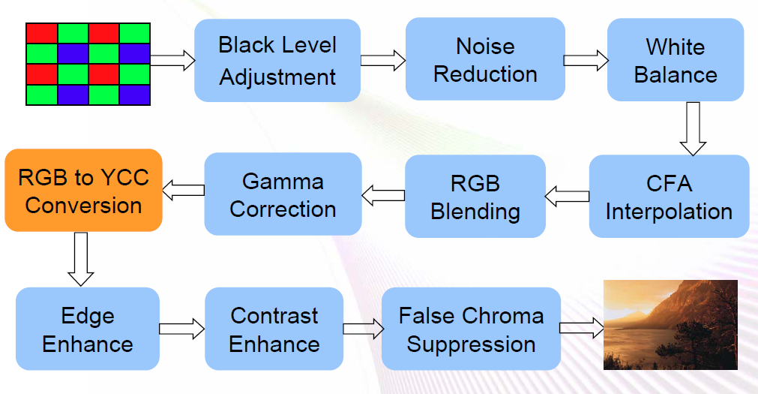

Slide 29
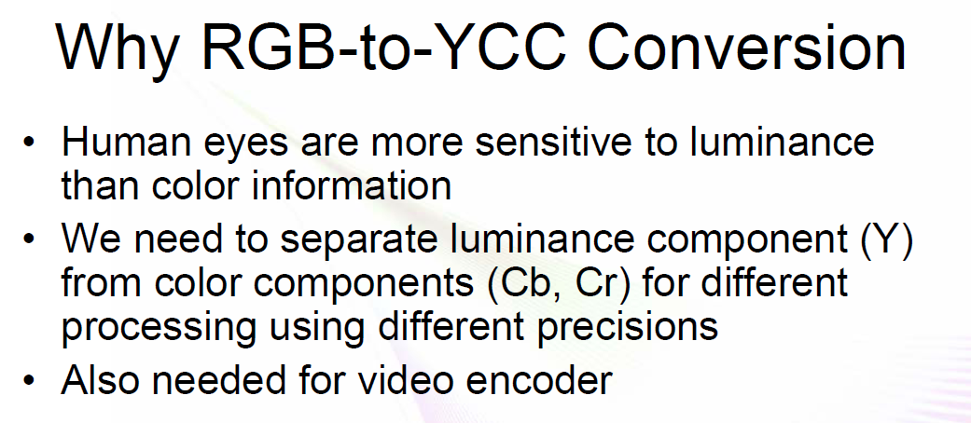
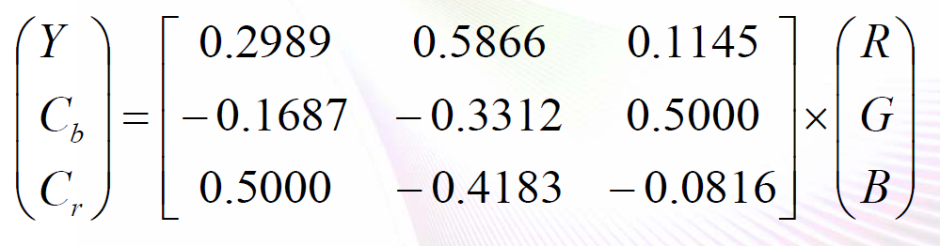

Slide 30
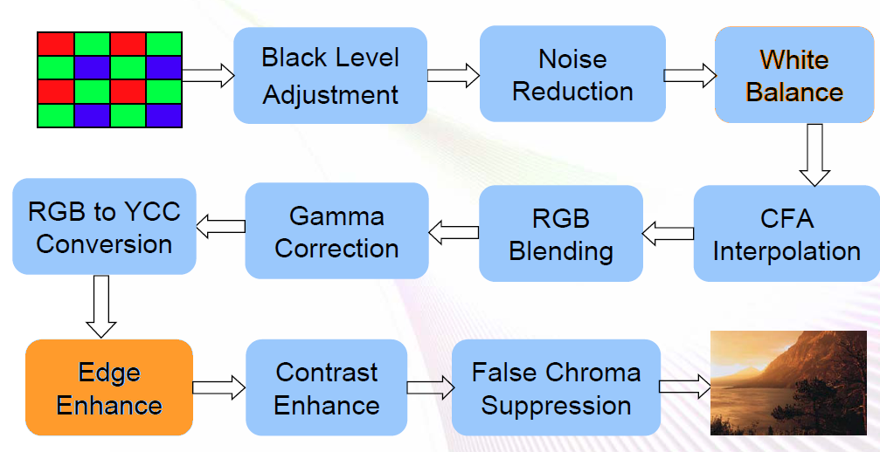

Slide 31
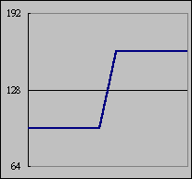
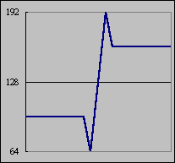
Edge Enhancement
A must - all cameras add edges
General approaches
Edge gain control
Edge detection module
Noise should not be enhanced

Slide 32
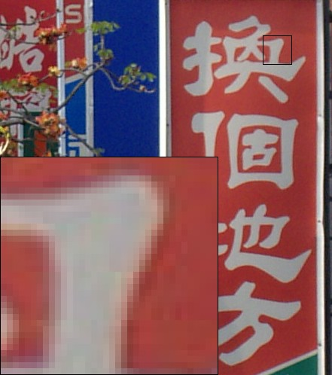
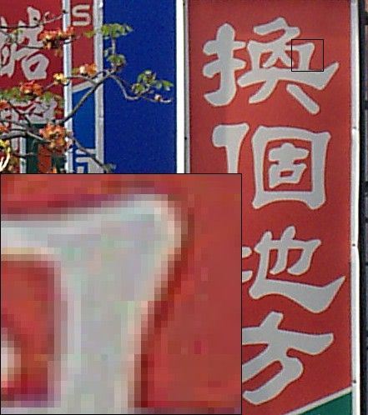
Edge Enhancement
Normal and strong edge enhancement

Slide 33
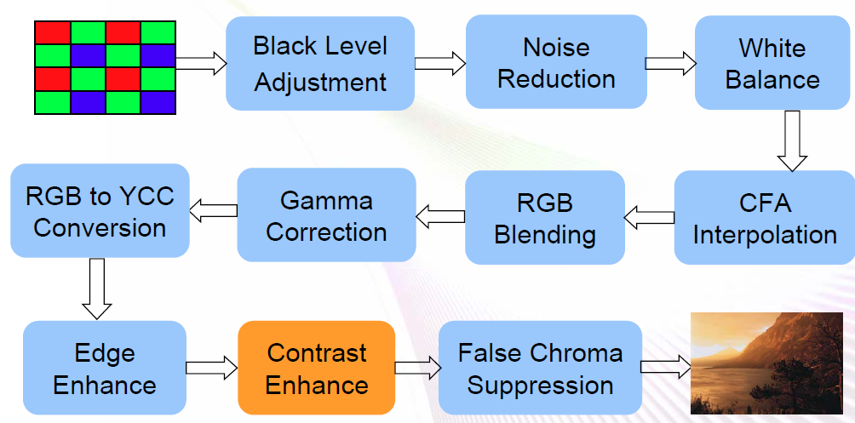

Slide 34
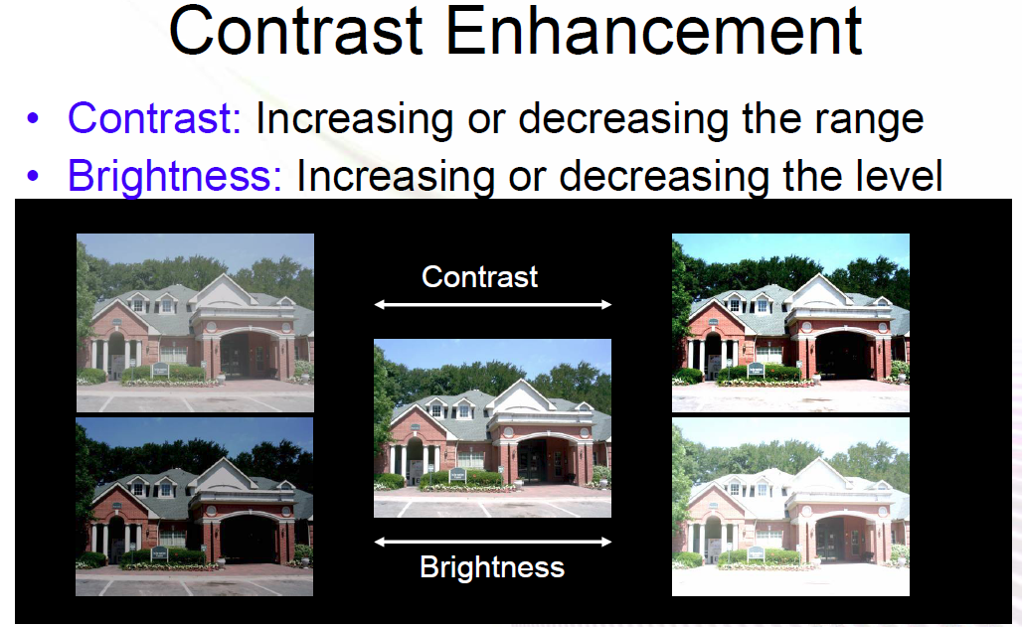

Slide 36
CCD vs CMOS (Backup)
CCD 將每一行中每一個畫素（pixel）的電荷信號依序傳入『緩衝器（電荷儲存器）』中，由底端的線路導引輸出至 CCD 旁的放大器進行放大，再串聯 ADC 輸出, 相對地，CMOS 的設計中每個畫素旁就直接連著『放大器』，光電訊號可直接放大再經由 BUS 通路移動至 ADC 中轉換成數位資料。
CCD的特色在於充分保持信號在傳輸時不失真（專屬通道設計），透過每一個畫素集合至單一放大器上再做統一處理，可以保持資料的完整性；CMOS的制程較簡單，沒有專屬通道的設計，因此必須先行放大再整合各個畫素的資料。

Slide 37
CCD vs CMOS (Backup)
 | CCD | CMOS
ISO sensitivity | H | L
Resolution | H | L
Noise | L | H
Power Consumption | H | L
Cost | H | L

Slide 38
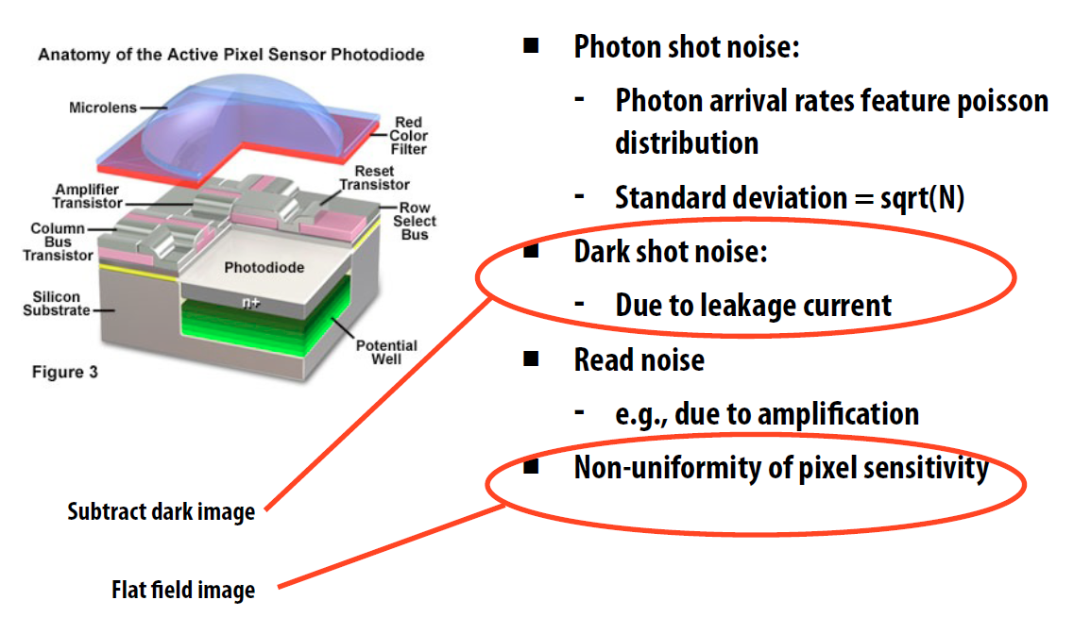
Measurement noise

Slide 39
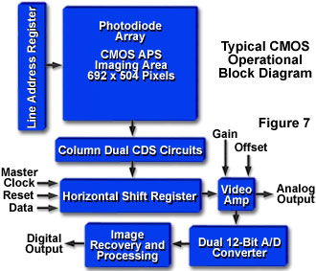
CMOS Image Sensor Operational Sequence

Slide 40
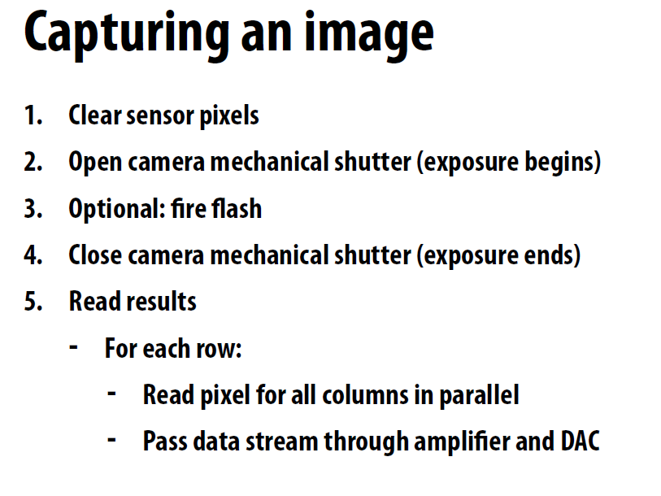

Slide 41
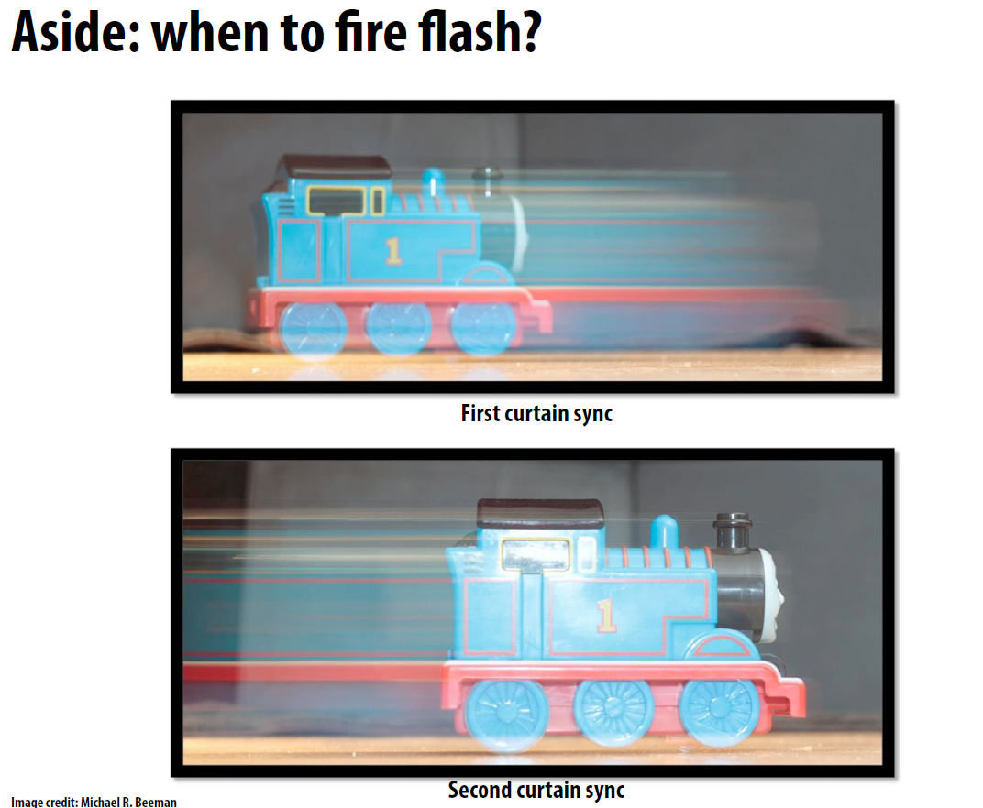

Slide 42
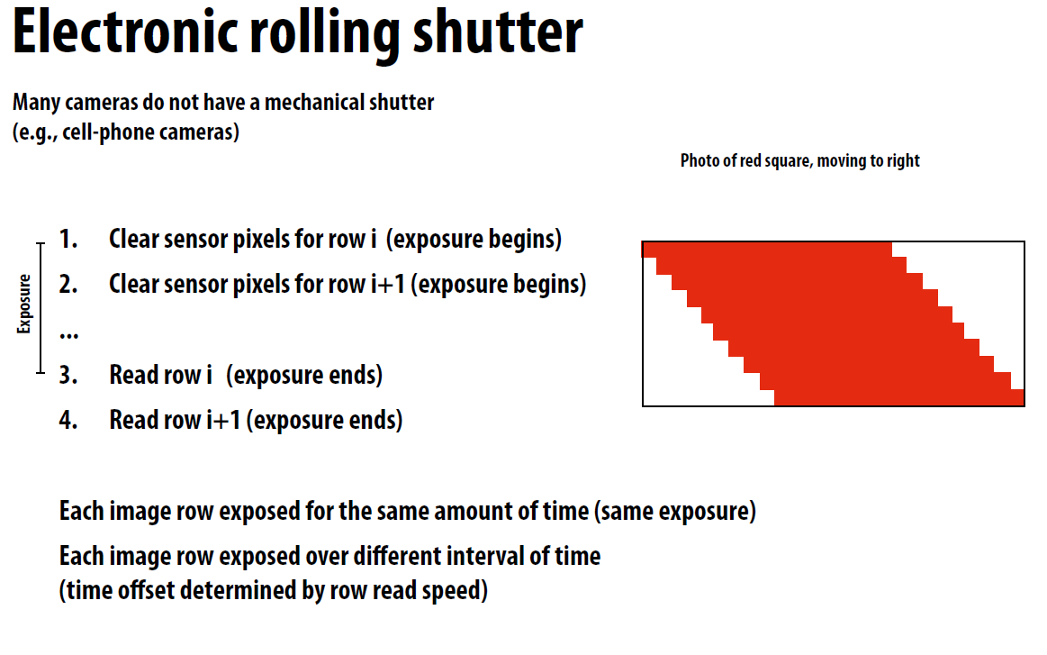

Slide 43
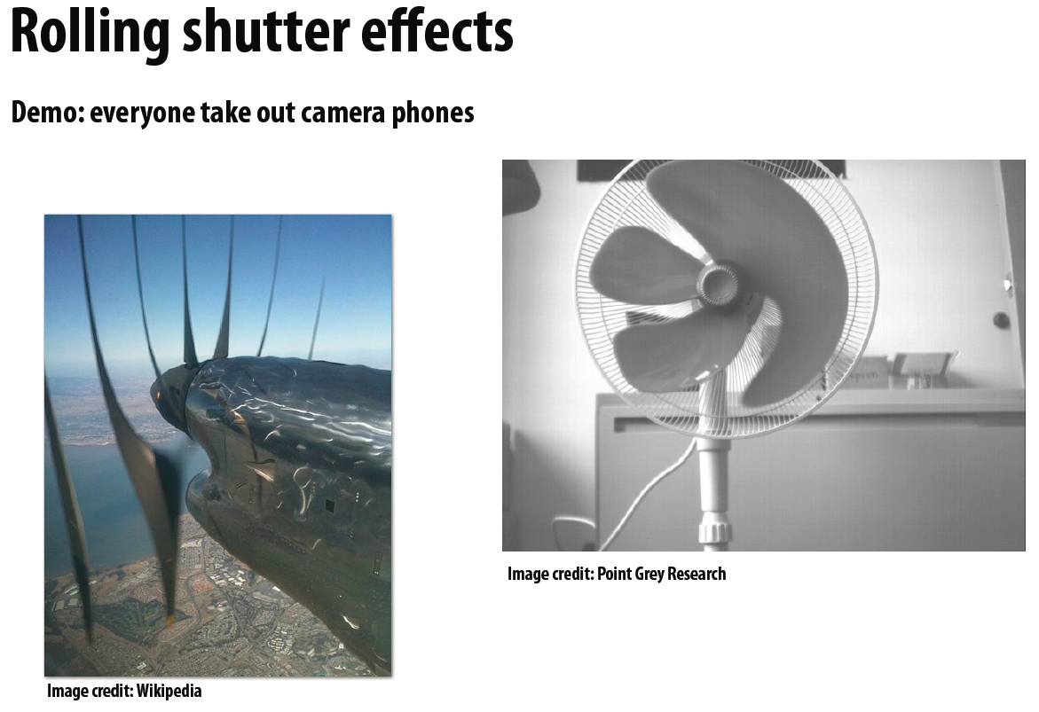

Slide 44
AE / AF / AWB (I)
Closed loop controls for passive 3A (active 3A are totally different)
Data collecting + control mechanism + converging algorithm
AE (auto exposure)
Collect luminance before gamma correction
Control exposure time, analog gain, iris,...
Converge luminance to AE target

Slide 45
AE / AF / AWB (II)
AWB (auto white balance)
Collect color statistic after white balancing
Control color gain
Converge color average to white target
AF (auto focus)
Collect focus value before edge enhancement
Control image plane position via AF motor
Find position with maximum focus value

Slide 46
Backup (1)
Wide dynamic range (WDR)
WDR is intended to provide clear images even under backlighting, where the intensity of illumination varies a lot—namely when there are very bright and very dark areas simultaneously in the camera's field of view. WDR allows an imaging system to correct for the intense back light surrounding a subject and thus enhances the ability to distinguish features and shapes on the subject.
High-dynamic-range imaging (HDRI or HDR)
reproduce a greater dynamic range of luminosity than is possible with standard digital imaging or photographic techniques.
capturing multiple standard exposure images, often using exposure bracketing Exposure variation in an HDR set is only done by altering the exposure time and NOT the aperture size;
Automatic Exposure Bracketing
The most common type of autobracketing is exposure autobracketing (often abbreviated to AEB for Automatic Exposure Bracketing or BR for Bracketing), where the camera is set to capture the same image several times with different exposure settings
The images are automatically combined, for example Automatic Exposure Bracketing into one High dynamic range image

Slide 47
Backup (2)
Exposure value
exposure value (EV) is a number that represents a combination of shutter speed and f-number, such that all combinations that yield the same exposure have the same EV value (for any fixed scene luminance). Exposure value is also used to indicate an interval on the photographic exposure scale, with a difference of 1 EV corresponding to a standard power-of-2 exposure step, commonly referred to as a stop.
Oversampled binary image sensor
Poisson分佈（Poisson distribution）
又稱卜瓦松小數法則（Poisson law of small numbers），是一種統計與機率學裡常見到的離散機率分佈，由法國數學家西莫恩·德尼·卜瓦松（Siméon-Denis Poisson）在1838年時發表。

Slide 48
Backup (3)
Edge enhancement is an image processing filter that enhances the edge contrast of an image or video in an attempt to improve its acutance (apparent sharpness).
The filter works by identifying sharp edge boundaries in the image, such as the edge between a subject and a background of a contrasting color, and increasing the image contrast in the area immediately around the edge. This has the effect of creating subtle bright and dark highlights on either side of any edges in the image, called overshoot and undershoot, leading the edge to look more defined when viewed from a typical viewing distance.
The process is prevalent in the video field, appearing to some degree in the majority of TV broadcasts and DVDs. A modern television set's "sharpness" control is an example of edge enhancement. It is also widely used in computer printers especially for font or/and graphics to get a better printing quality. Most digital cameras also perform some edge enhancement, which in some cases cannot be adjusted.

Slide 49
抗眩光處理(Anti-Glare),
為利用擴散反射的原理,將外來光源以亂反射達到眩光目的.眩光表面為一凹凸不平的狀態,鍍膜或製作過程中需要非常注意表面凹凸顆粒的大小均勻程度,否則將會發生亮點(Spark)現象,嚴重影響螢幕可視性及舒適性. 特點: 1. 表面硬度高,耐擦傷性佳 2. 可視性及舒適性佳,適於display方面應用 3. 可提供AG玻璃,AG壓克力,PC等產品 4. 具有高度價格競爭力

